Slide 1

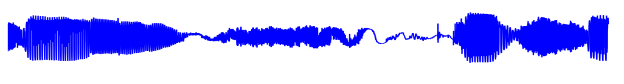
Singing Voice Generation
Nir Raviv Roi Tabach Andrey Leshenko
Supervisor: Prof. Amir Globerson

Slide 2

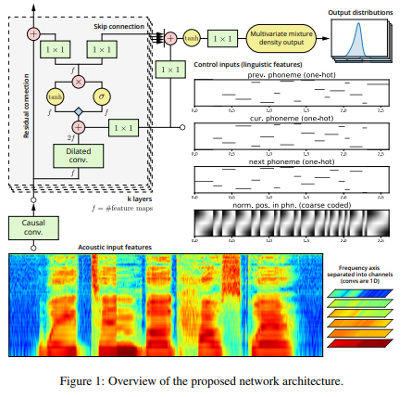
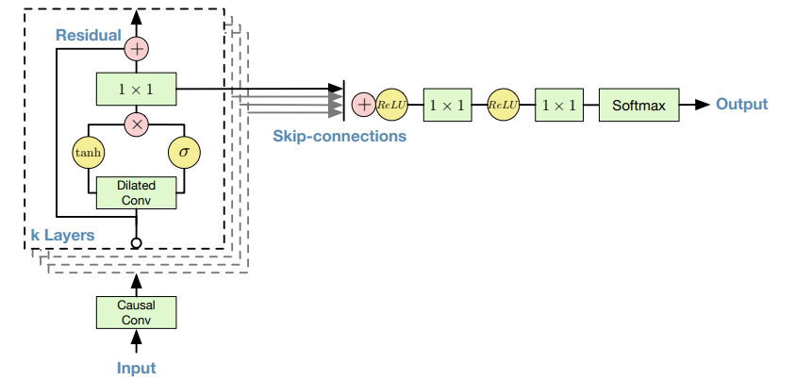
The Problem:
Generate singing voices base on music notes and text as input
This method can help composers and music producers to be more creative.
Related Work:
WaveNet (2016)
NPSS (2017)
Was state-of-the-art methods in TTS and was followed by most of the TTS methods
Good results in speaker recognition and music generation
State-of-the-art singing synthesizer
A parametric output model Learned from text encoded as phonemes and notes.

Slide 3
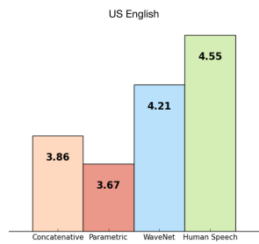
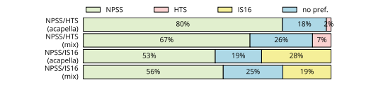
Proposed Method
Two steps system: TTS and singing generator based on state-of-the-art models.
Generic system: train over one language and test over other languages.
Evaluation Method:
We will evaluate both TTS and Singing generator separately and combined using Mean Opinion Score (MOS) tests.
We will compare our final results to the state-of-the-art systems and to original songs.
For example:

